Slide 1

Micro-Credit Defaulter Model
Submitted By
MEGHA SINGH

Slide 2
ACKNOWLEDGEMENT
The internship opportunity I have with Flip Robo Technologies is a great chance for learning and professional development. I perceive this opportunity as a big milestone in my career development. I will strive to use gained skills acknowledge in the best possible way.
I would like to extend my appreciation and thanks for the mentors from Data Trained and professionals from FlipRobo Technologies who had extended their help and support.

Slide 3
Introduction
Business Problem Farming:
This is a Business Problem which helps Microfinance Institution and which ever company who gives the loan reduce the credit risks by granting potential Defaulter.
Conceptual Background of the Domain Problem:
Earlier advancement of Data Science ,loan giving companies used to high risk of Defaulting. Many a consumer would display inconsistent financial and repayment behavior after being approved the loan. Machine Learning may helps lender predict potential defaulters before approving their past data. The consumer income and repayment behavior can be important metrics.
Review of Literature:
A Microfinance Institution is an oragnization that offers finacial services to low income populations.MFS becomes very useful when targeting the unbanked poor families living in village area with not much source of money.The Microfinance Services provided by MFI is group loans,agriculture loans,Individual Business loans so on.

Slide 4
Motivation for the Problem Undertaken
We are working with a such a client in telecom industry. They are fixed wireless telecommunication network provider. They have launched various products and developed its business and organization based on the project budget operator model, offering better products at lower price to all value customers through strategy of disruptive innovation that focuses on the subscriber. They understand the importance of communication and how its affects person’s life thus, focusing on the providing their services and products to low income families and poor customers that can help them in the need of hour.

Slide 5
Data Inputs- Logic- Output Relationships
I found the data was imbalanced for the target feature (87.5% for non-defaulter and 12.5% for defaulter).Also I found that the data has some unrealstic values such as 998650 days which is not possible also there were negative values.all these unrealstic values were drop which cause data loss of 8 to 9% only.

Slide 6
Data Preprocessing
Data Exploration and cleaning on data exploration,i found that that dataset was imbalanced for that target feature(87.5% for Non-defaulter and 12.5% for defaulters).Also I found that the data had some unrealistic values such as 998650 days which is not possible.Also there were negative values .All the unrealistic value drop which caused 8% to 9% data loss only.

Slide 7
Testing of Identified Approaches (Algorithms)
I performed 7 Algorithms in which 4 were model library like :
Logistic Regression
SVC
DecisionTreeClassifier
KNeighborsClassifier
Out of 7, 3 were boosting model library like
RandomForestClassifier
AdaBoostClassifier
GradientBoostingClassifier

Slide 8
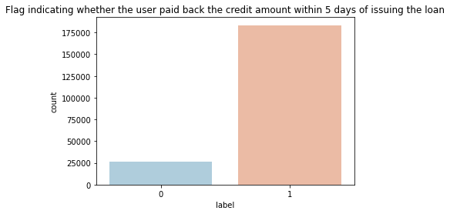
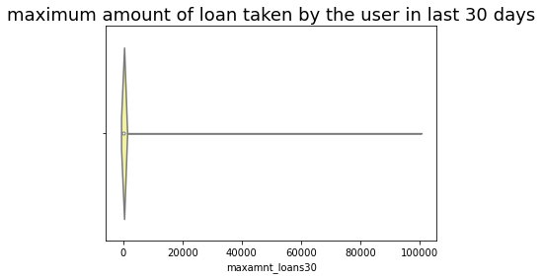
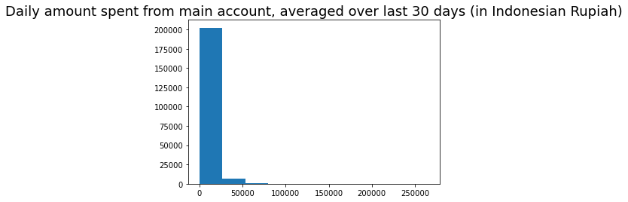
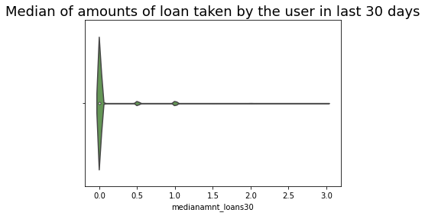
Exploratory Data Analysis(EDA)

Slide 9
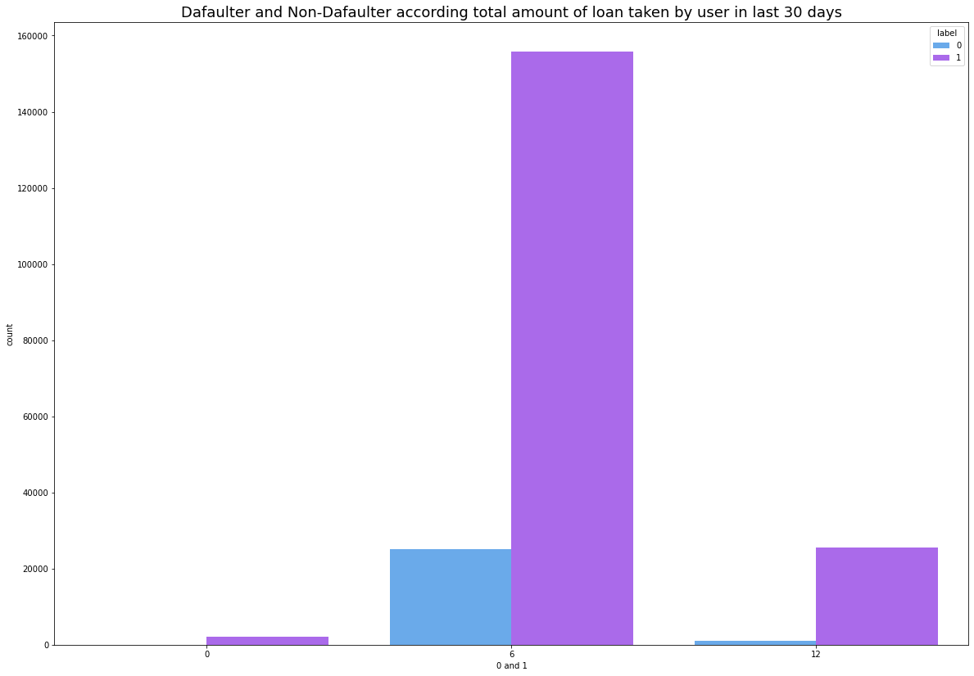
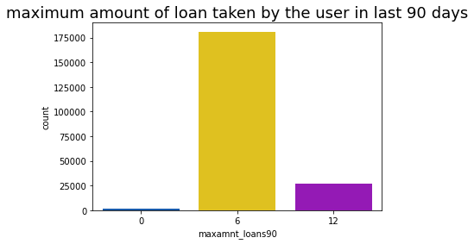
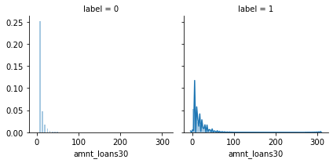

Slide 10
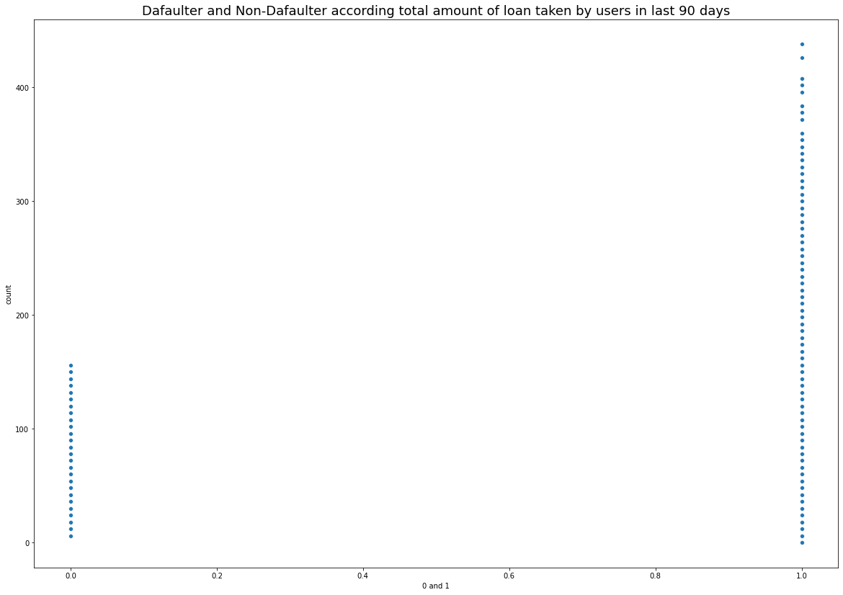

Slide 11
Bivariate Analysis
With the help of Bar Plot we are able to see the success and failure label data for the columns basically the feature data.

Slide 12
Bivariate Analysis
Using the line plots I checked the object data type for date and mobile number data present in our dataset.

Slide 13
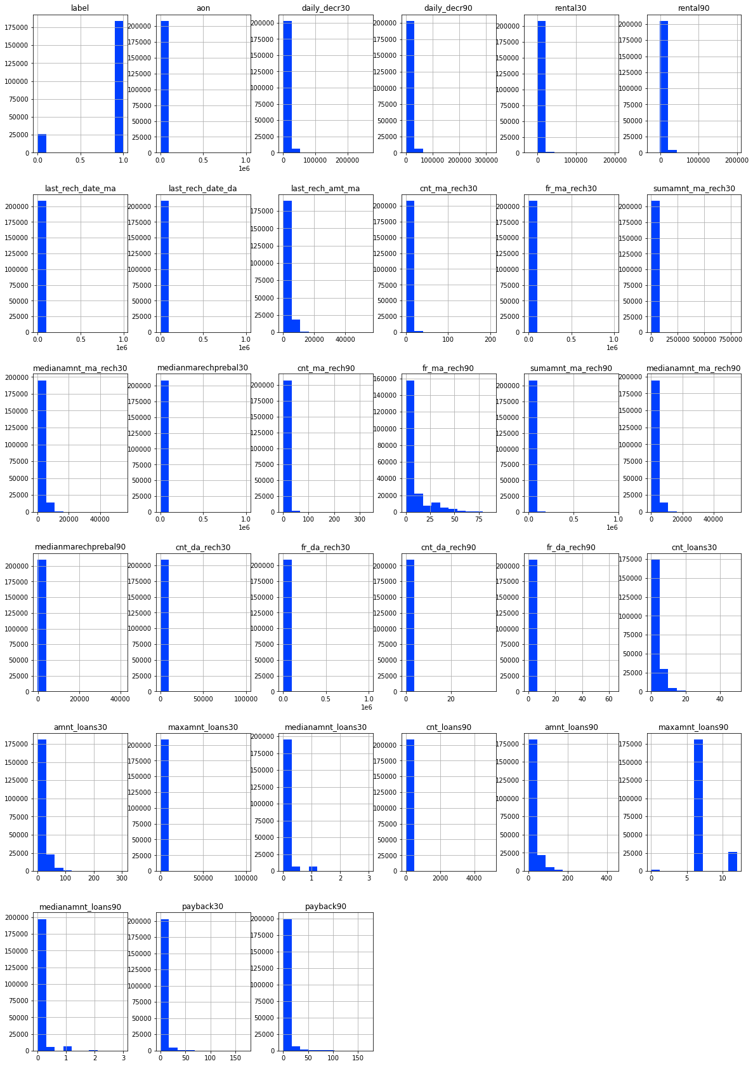
Multivariate Analysis
I used the histogram to check through all the column details ensuring that the distribution is displayed for further analysis

Slide 14
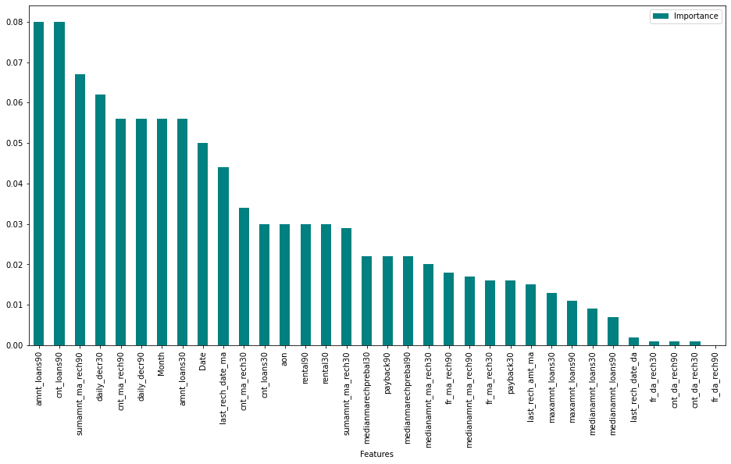
Importance Bar
Using the Random Forest Classifier we were able to get the importance data and dropped the least contributing feature columns.

Slide 15
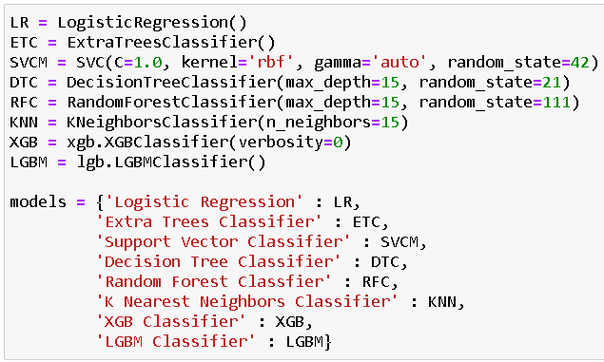
I made use of 8 Classification Machine Learning Models to check through the best accuracy along with cross validation score.

Slide 16
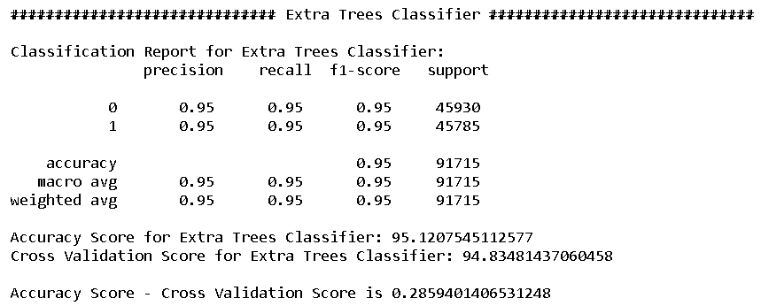
Report on Best Model
I chose Extra Trees Classifier as my best model and then proceed to perform hyper parameter tuning on the same

Slide 17
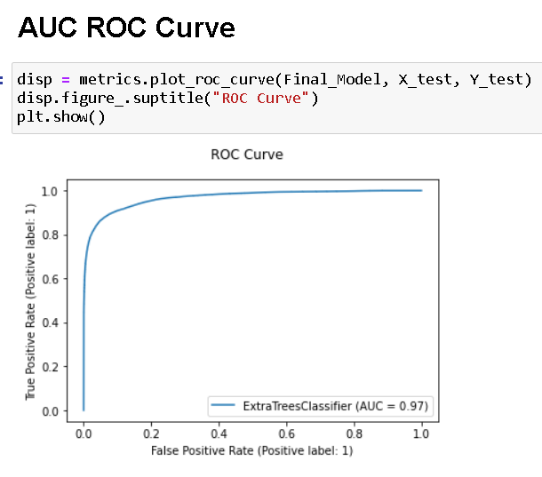
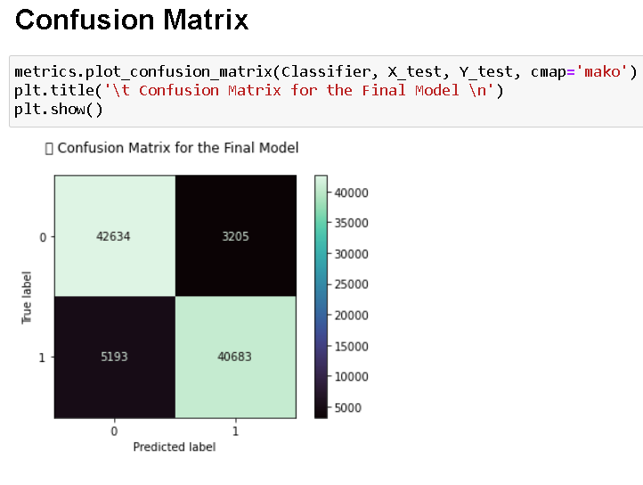
Hyper parameter tuning result

Slide 18
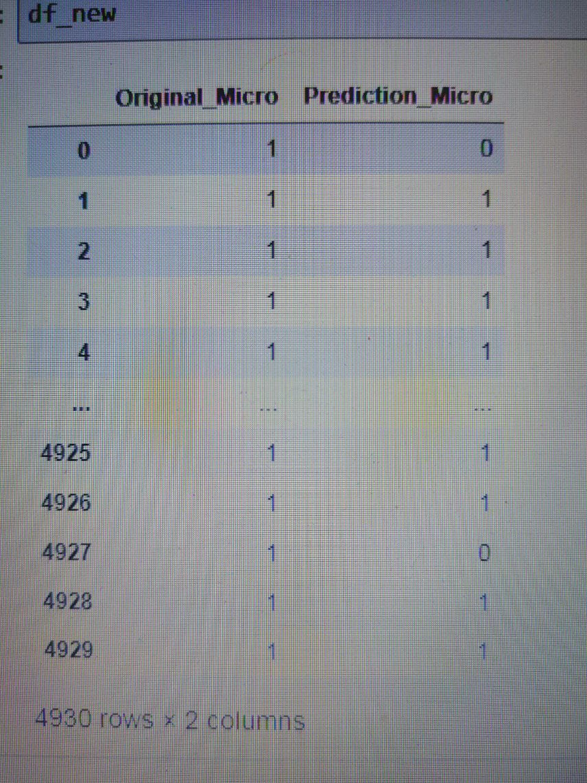
Key Findings and Conclusions of the Study

Slide 19
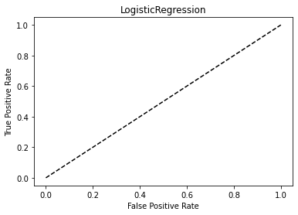
LogisticRegression

Slide 20
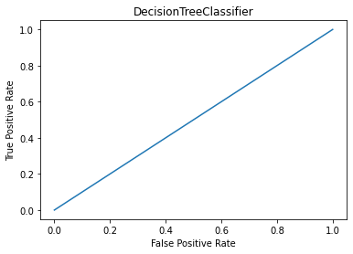
DecisionTreeClassifier

Slide 21
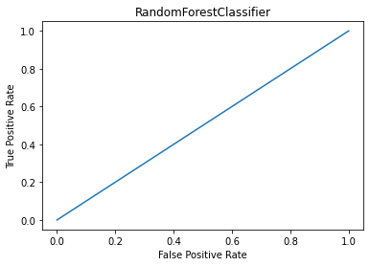
RandomForestClassifier

Slide 22
Conclusion
Key Findings and Conclusions of the Study: From the final model MFI can find if a person will return money or not and should a MFI provide a load to that person or not judging from the various features taken into consideration.
Learning Outcomes of the Study in respect of Data Science: I built multiple classification models and did not rely on one single model for getting better accuracy and using cross validation comparison I ensured that the model does not fall into overfitting and under fitting issues. I picked the best one and performed hyper parameter tuning on it to enhance the scores.

Slide 23
Limitations of this work and Scope for Future Work
Limitation is it will only work for this particular use case and will need to be modified if tried to be utilized on a different scenario but on a similar scale.
Scope is that we can use it in companies to find whether we should provide loan to a person or not and we can also make prediction about a person buying an expensive service on the basis of there personal details that we have in this dataset like number of times data account got recharged in last 30 days and daily amount spent from main account, averaged over last 30 days (in Indonesian Rupiah) so even a marketing company can also use this.

Slide 24


